Slide 1
Programming 4
12.2 Functional Programming 2
Semester 2, 2019

Slide 2
Last session
Functions as objects – first class objects/citizens
Higher-order functions
Lambda functions

Slide 3
This session
List comprehensions
Iterators
Generators
Decorators

Slide 4
List comprehensions
A more succinct syntax for map(fn1, filter(fn2, sequence))
[expression for variable in iterable conditional]
expression – a mathematical equation or function
variable – a placeholder, as in a foreach loop
iterable – any collection that has a next function
conditional – a filter on the items in the collection
Returns a new list containing all the results

Slide 5
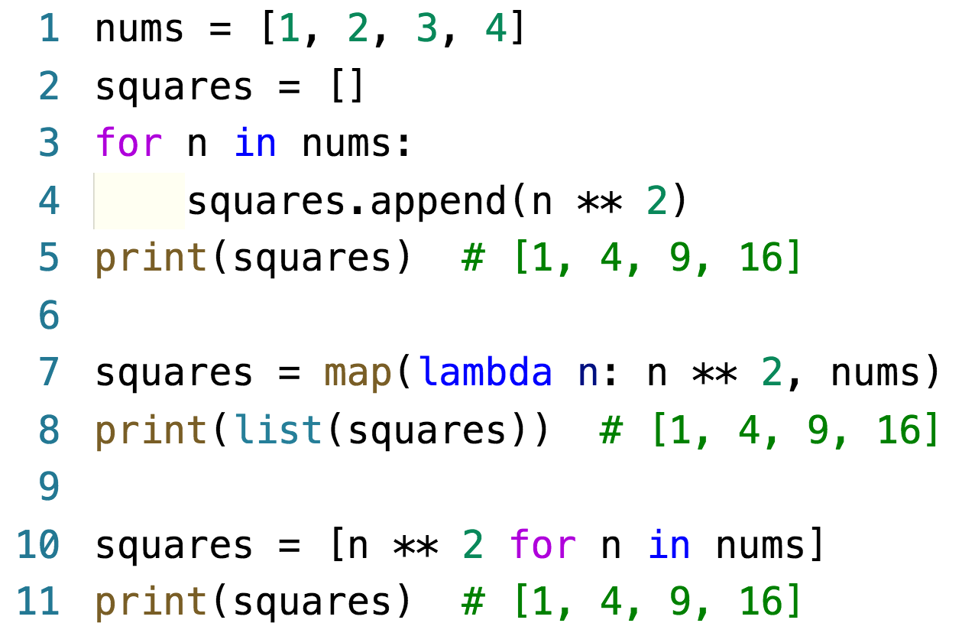
List comprehensions
Imperative syntax
Map
List comprehension

Slide 6
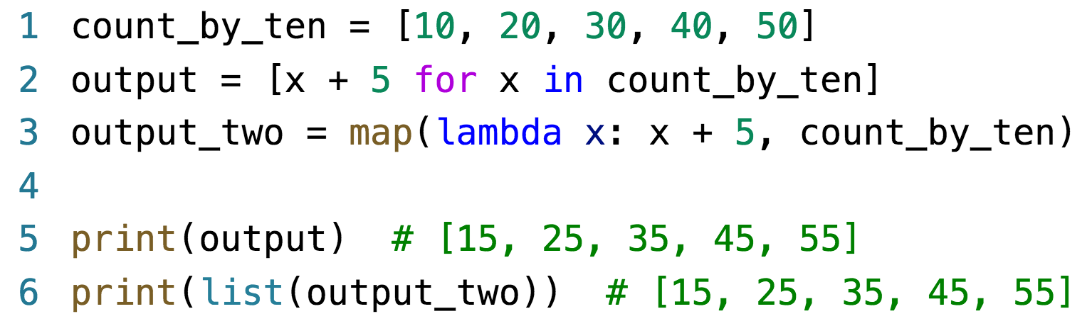
List comprehensions
Doesn’t have to be a complete function like lambda
There can sometimes be a performance advantage
Considered idiomatic Python

Slide 7
List comprehensions
List comprehensions are significantly faster than imperative style

Slide 8
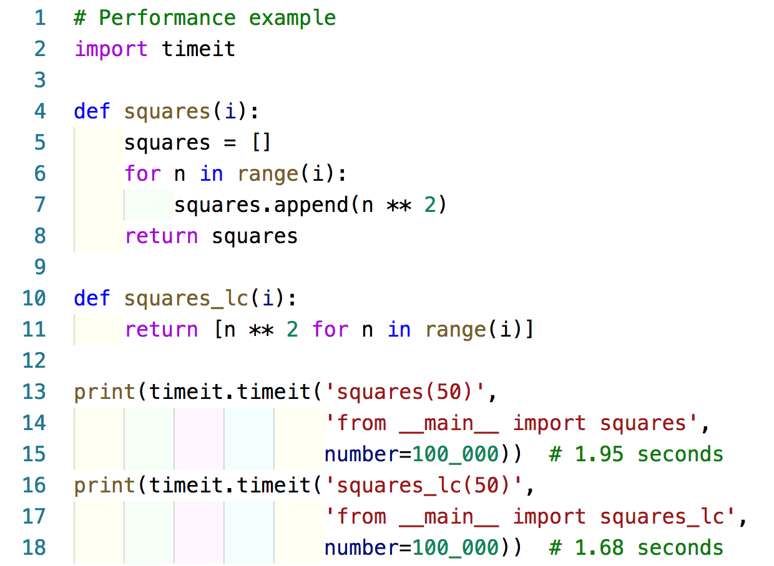
Example – imperative vs list comprehension

Slide 9
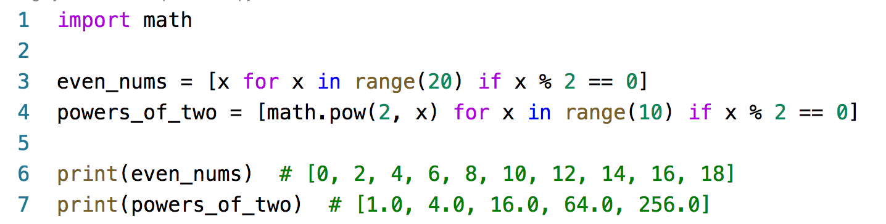
List comprehensions
Conditional filtering
Libraries can be used within the list comprehension

Slide 10
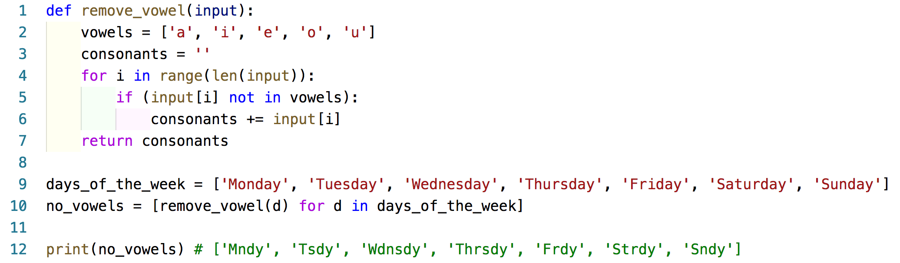
Example – list comprehensions

Slide 11
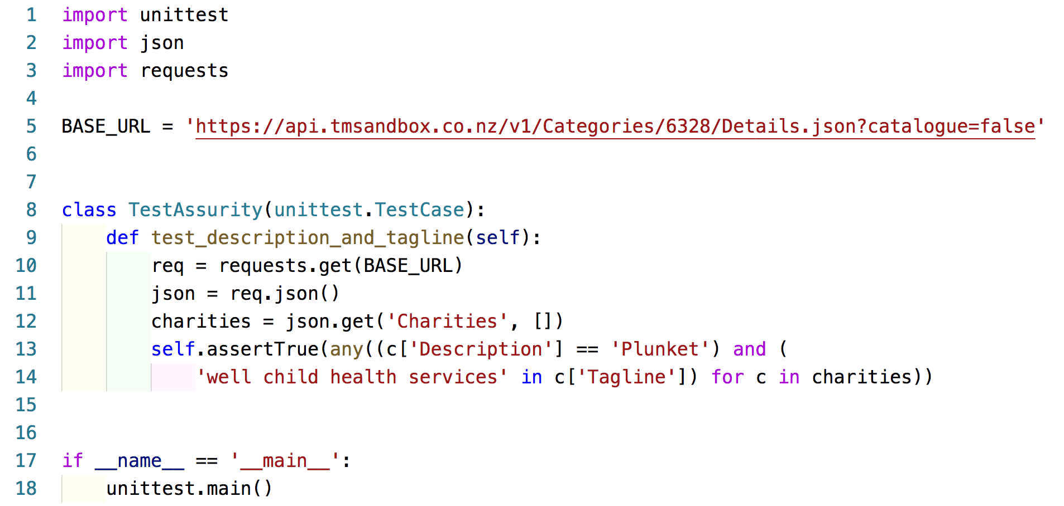
Example – list comprehensions

Slide 12
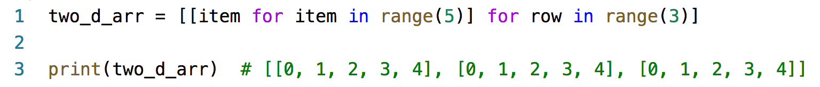
List comprehensions
Nested list comprehensions
Returns a list of lists

Slide 13
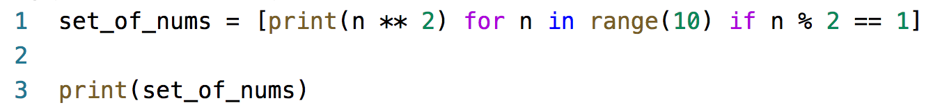
List comprehensions
Don’t call functions with side effects – print()
Only use if you are making lists
Should only be used for turning one list or
iterable into another list

Slide 14
Iterators
Can be iterated over
Can be processed one element at a time
To make an iterable class:
Define method __iter__
Define method __next__
Raise the StopIteration exception

Slide 15
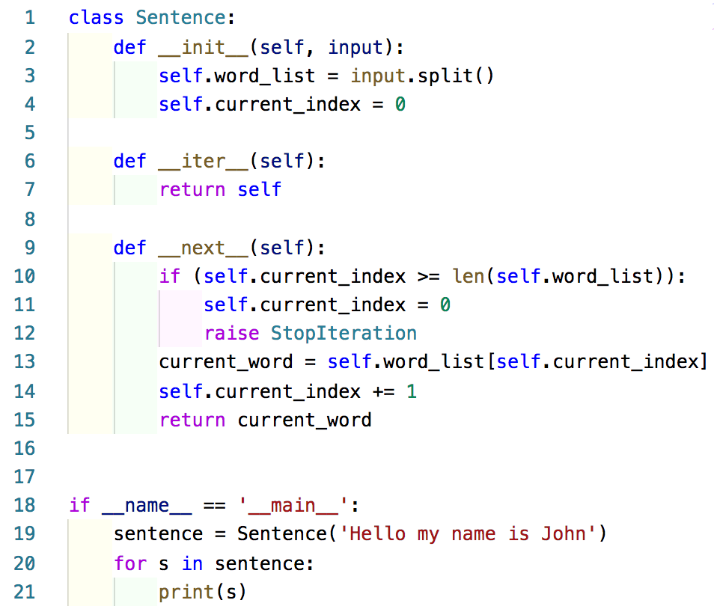
Example – iterators

Slide 16
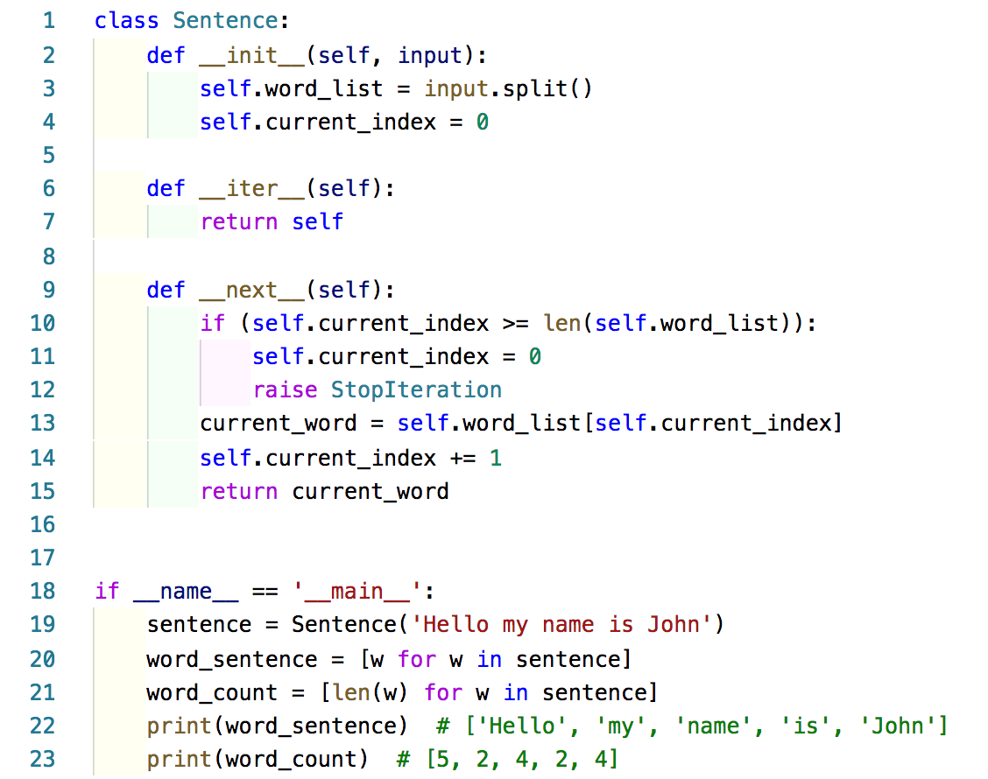
Example – iterators

Slide 17
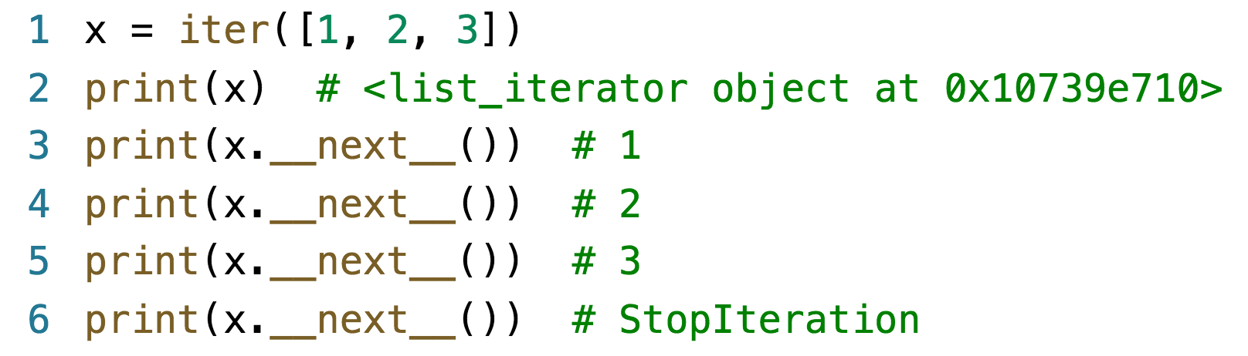
Iterators
Built-in function iter takes a sequence and
returns an iterator
Each time we call the next method, the iterator
gives us the next element
If there are no more elements, it raises a
StopIteration

Slide 18
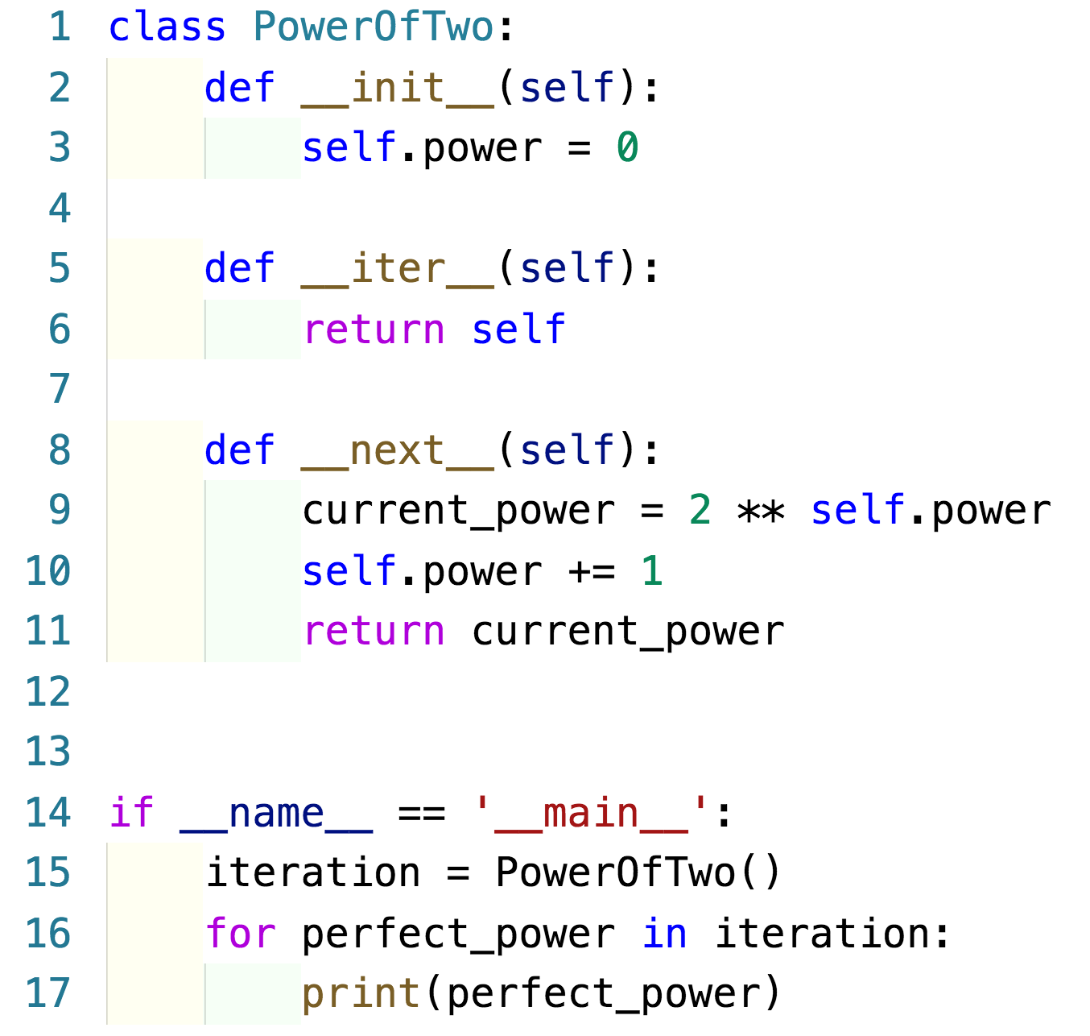
Example – iterators

Slide 19
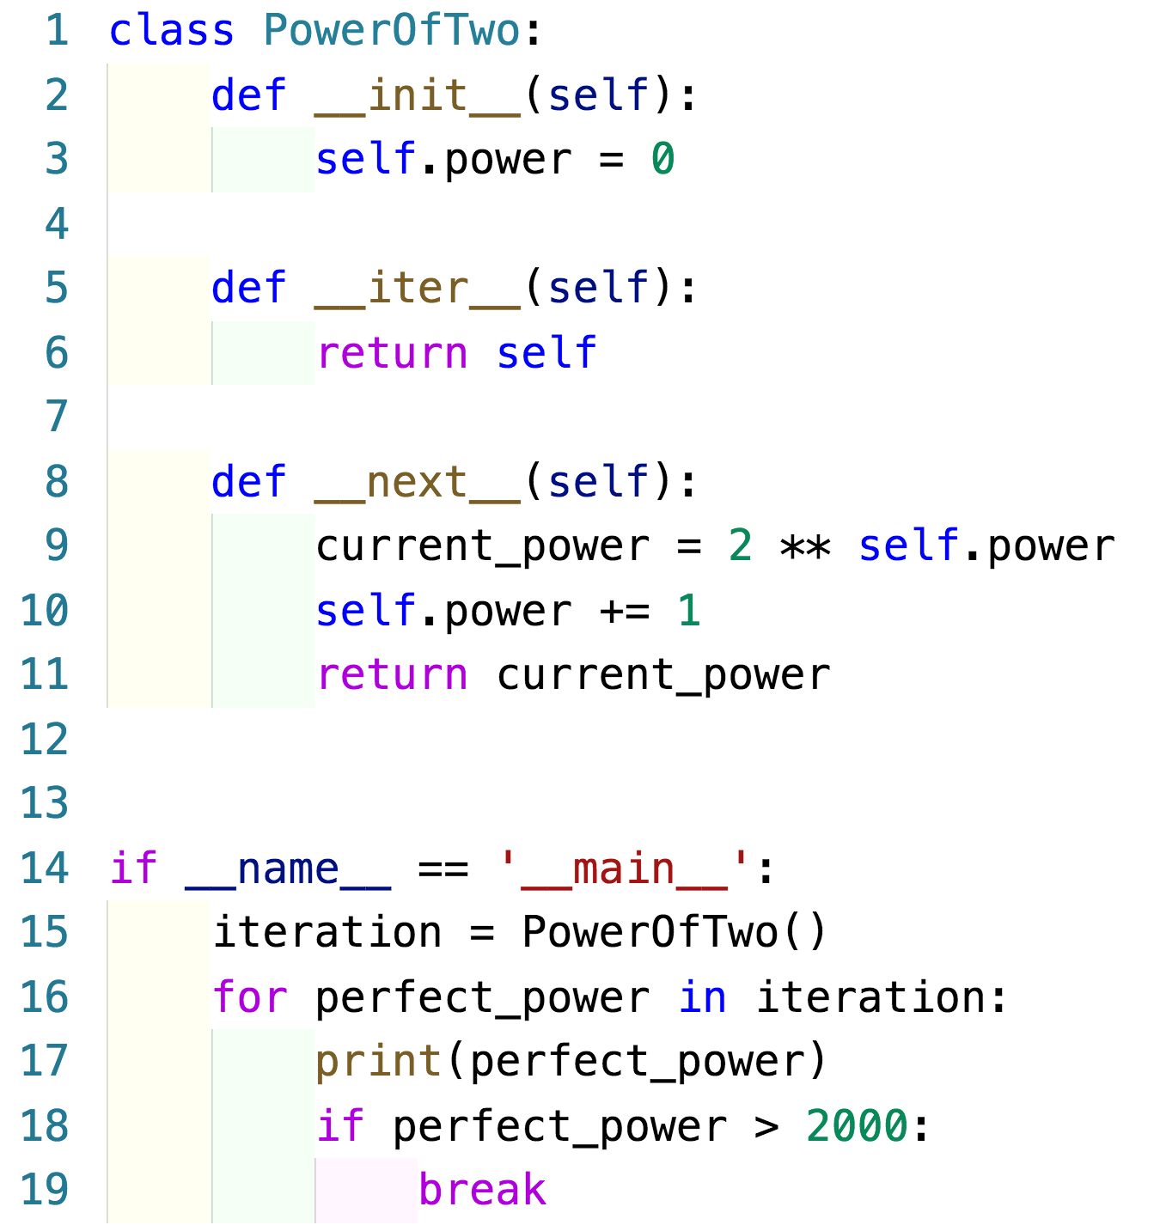
Iterators
It is our responsibility to break out
__next__ never raises StopIteration

Slide 20
Generators
A special kind of function that is iterable
Generators do not exit when they return a
value, they simply pause
The next time they are called, they pick up
where they left off
They use yield rather than return

Slide 21
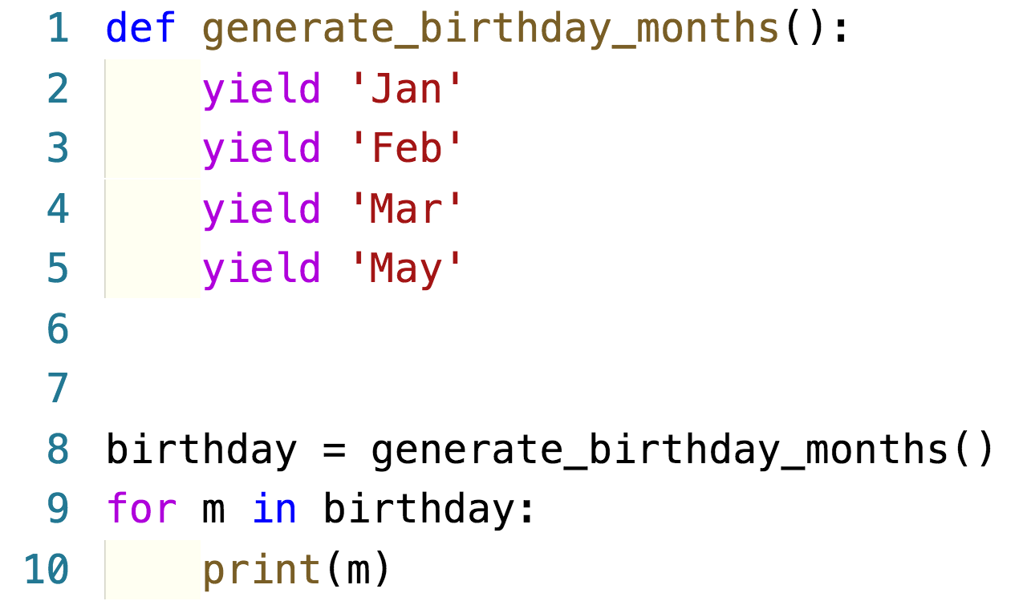
Generators
Each yield returns a value and pauses
Be careful with __next__()
The yield command defined the next function
StopIteration is treated as an exception

Slide 22
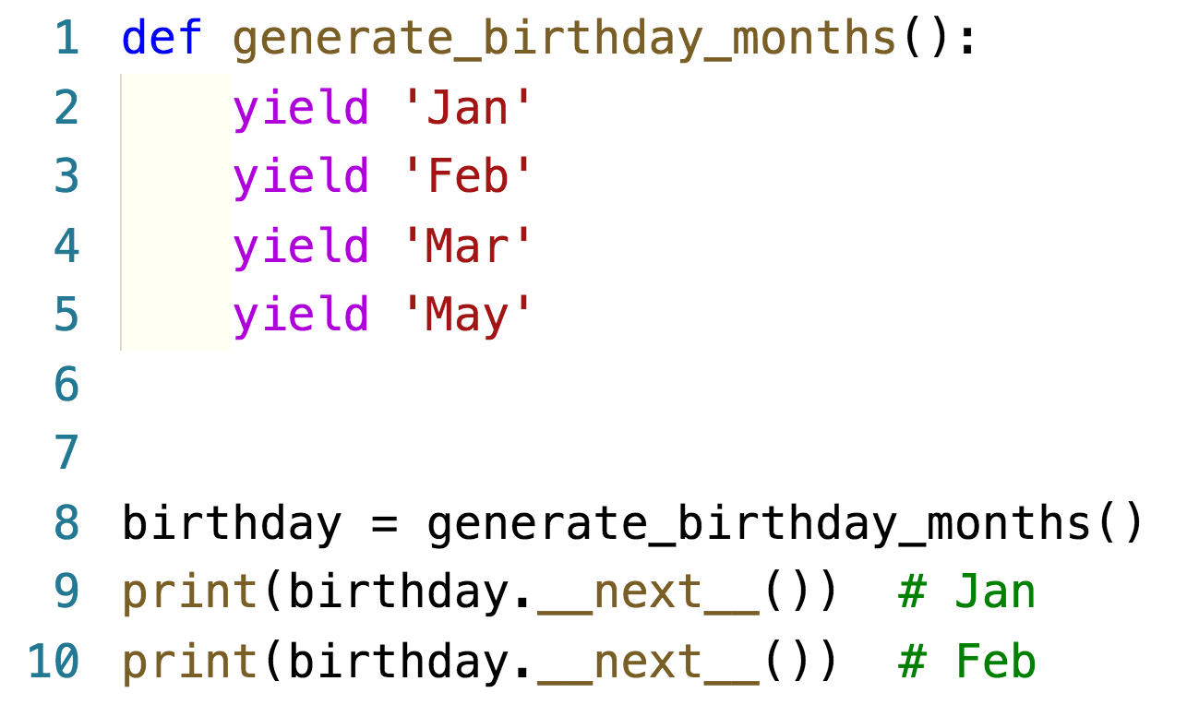
Example – generators

Slide 23
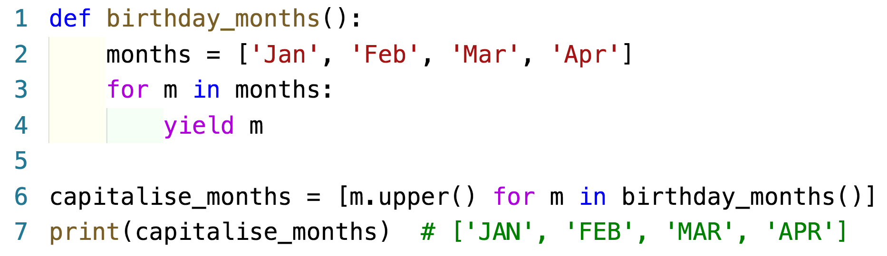
Generators
Yield inside a for loop
Using generator object in a list comprehension

Slide 24
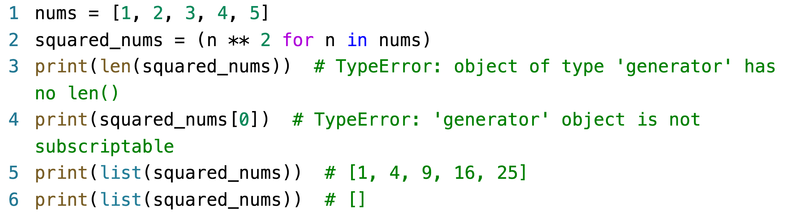
Generator expressions
If you change your list comprehension from
[] to () - generator expression:
Doesn't know it’s length
Can’t index
Single use iterable

Slide 25
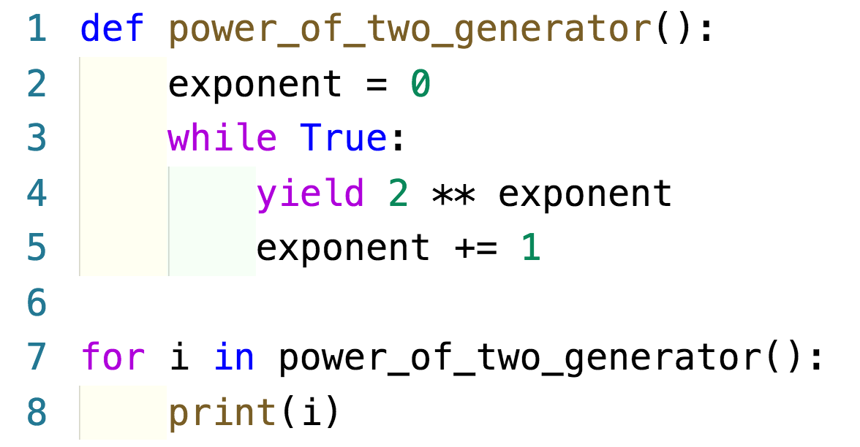
Infinite generators
Like infinite iterators, there are infinite generators

